Slide 1
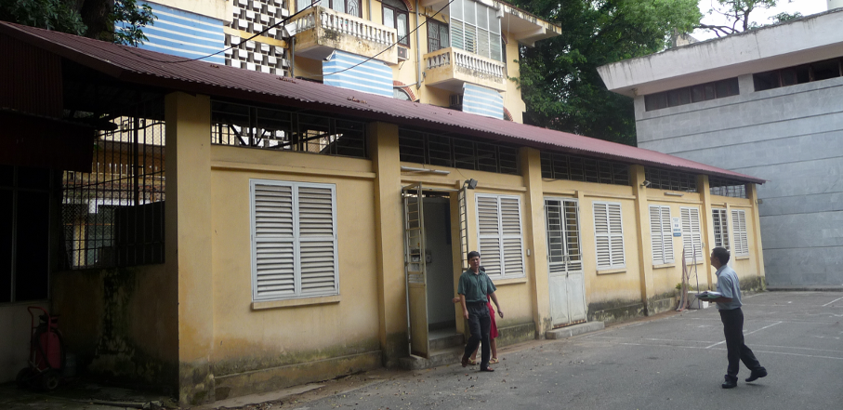


EVM Introduction
EVM—setting a standard for the vaccine supply chain

Slide 2
Contents
What is EVM?
The History of EVM
The EVM Assessment:
What does it assess?
How does it assess?
EVM Results:
Assessment Results
Improvement Plans

Slide 3
What is EVM?
Notes:
Yes

Slide 4
What is EVM?
EVM sets standards for the vaccine supply chain
1.2.1 A lot release certificate
accompanies every batch of vaccine.
2.1.2 All freezer rooms and cold rooms used for storing vaccine are temperature mapped.
2.2.3 Complete temperature records for every freezer room, cold room, vaccine freezer, vaccine refrigerator and refrigerated vehicle are maintained.
2.2.5 An internal review of temperature records is carried out every month.
3.4.2 Passive container capacity is sufficient to meet maximum daily demand.
3.5.1 Contingency plans designed to deal with foreseeable emergencies are developed.
4.3.4 The use of CFC gases in refrigeration equipment is phased out in accordance with UNICEF/WHO policy.
6.1.2 All stock transactions are recorded in the stock records by the end of the working day.
6.2.1 A maximum stock level, a reorder level and a safety stock level are established for each vaccine and for each consumable.
7.2.1 An effective system for managing short shipments to receiving stores is established.
8.1.5 Opened vials of freeze-dried vaccines
are discarded at the end of the session.
9.1.2 Every cold store facility has a copy of relevant standard operating procedures.

Slide 5
What is EVM?
EVM is a continuous quality improvement process
EVM 2009
Assessment
Plan for Improvement
Implement Improvement Plan
EVM 2012

Slide 6
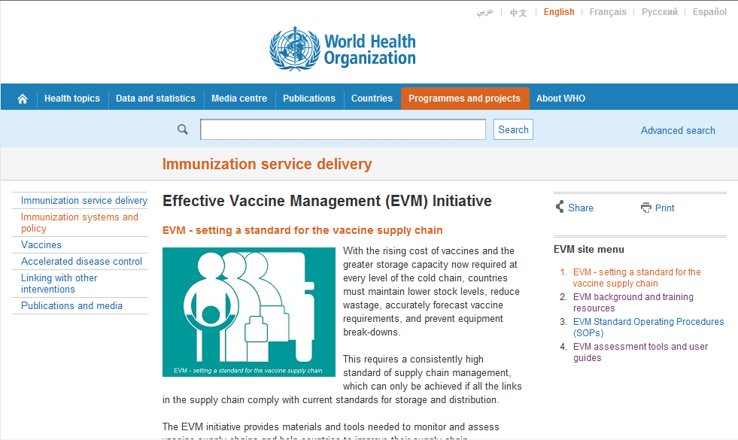
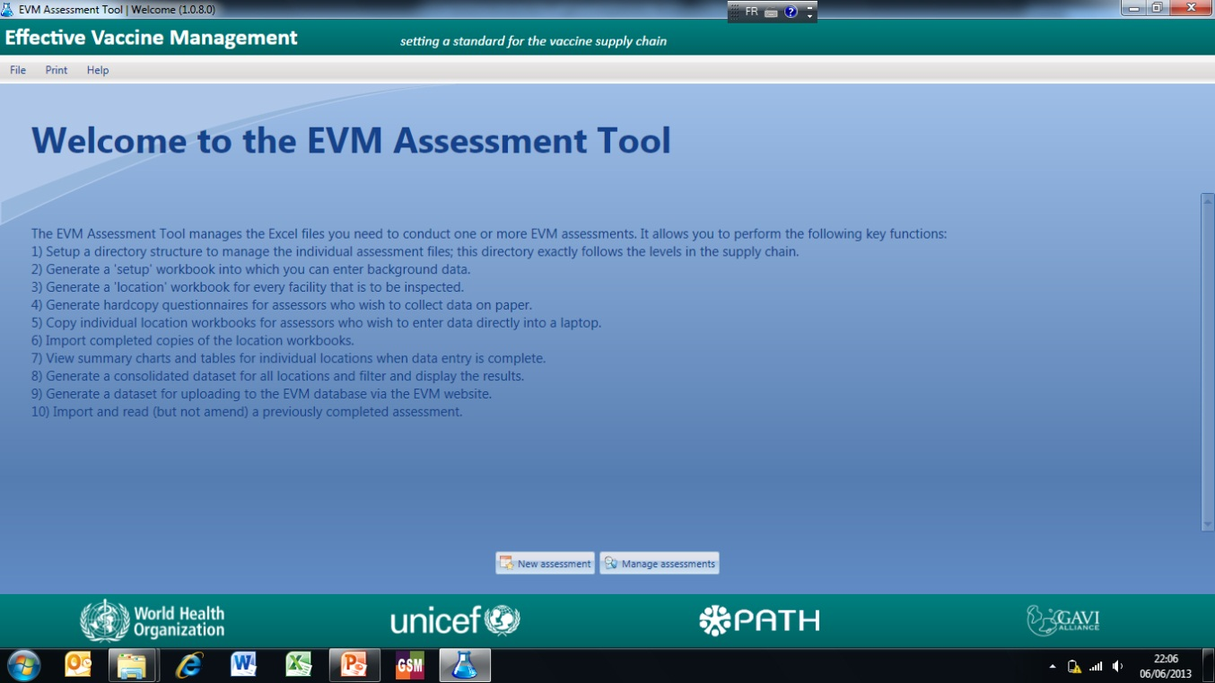
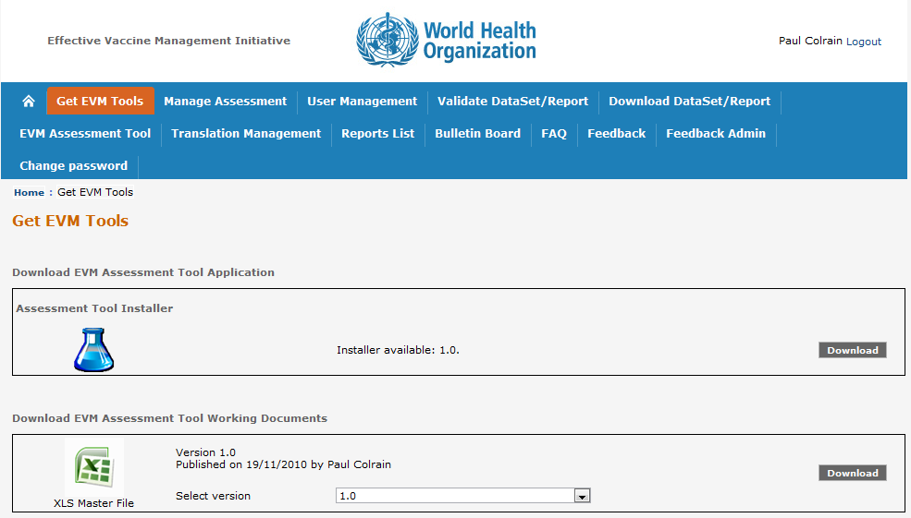
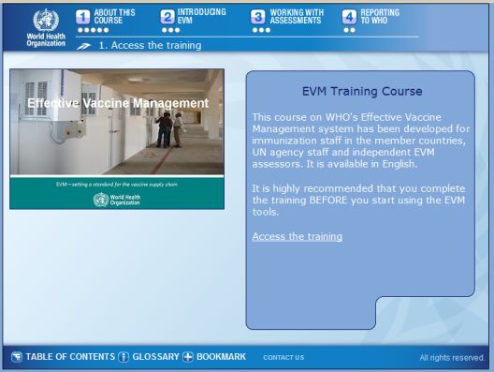
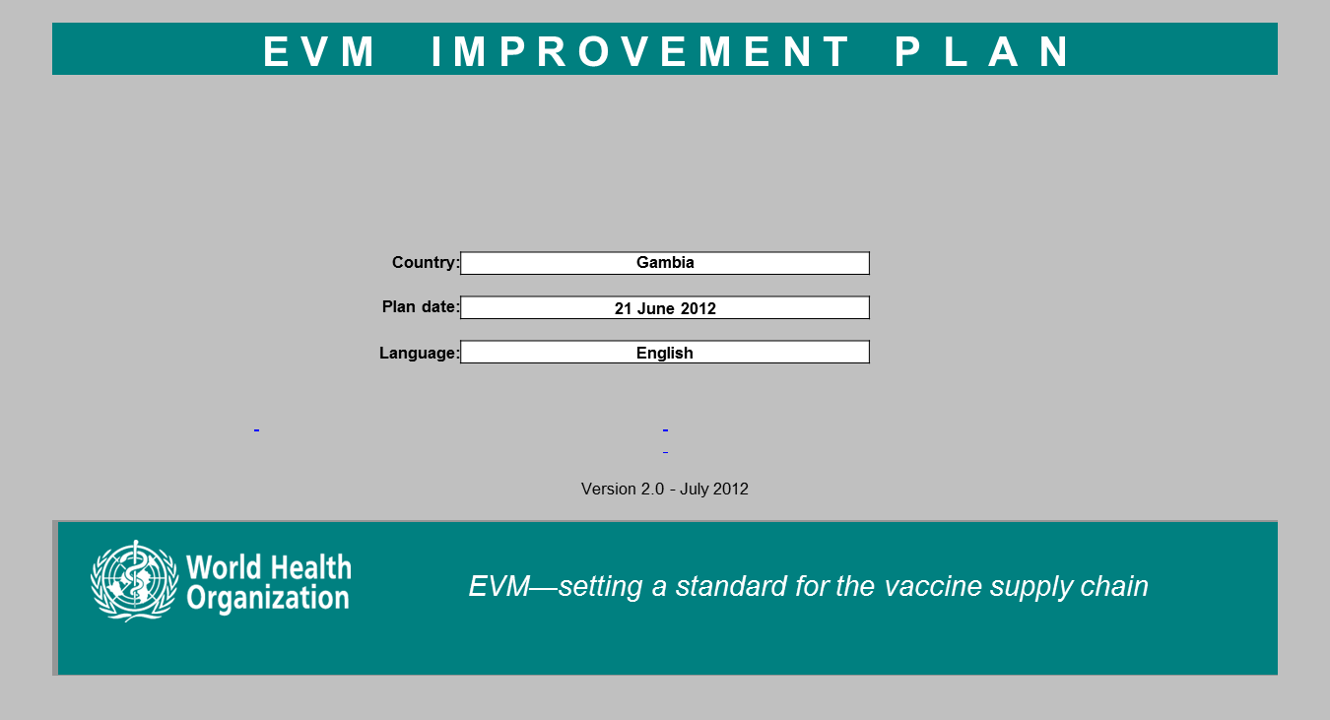
What is EVM?
EVM is a set of resources to facilitate continuous quality improvement
http://www.who.int/immunization_delivery/systems_policy/evm/en/
EVM
Standard Operating Procedures
Effective Vaccine Management Initiative
Version 3
June 2013
EVM—setting a standard for the vaccine supply chain
Notes:
and user-guides.
Public website gives access to all SOPs, tools, user-guides, assessment website, and online EVM training course

Slide 7
The History of EVM
Notes:
Yes

Slide 8
The History of EVM
Milestones in the life of EVM and its parents
34 EVM
VMA concept
23 EVM
18
16
14
10 VMA
2 EVM
11
11
7
8 EVM
2000
2001
2002
2003
2004
2005
2006
2007
2008
2009
2010
2011
2012
2013
EVSM concept
EVM Initiative
EVSM (Effective Vaccine Store Management) 35 assessments 2003-2009
VMA (Vaccine Management Assessment) 52 assessments 2003-2009
EVM (Effective Vaccine Management) ~70 assessments 2009-2013

Slide 9
The History of EVM
EVM assessment uptake
Pilot EVM Assessments in Vietnam and Senegal in 2009.
At the end of 2010 GAVI requires all new vaccine support applicant countries to carry out an EVM assessment and prepare an improvement plan.
4
3
At the end of 2011 GAVI requires all countries in receipt of support to provide an up-to-date improvement plan implementation status each year.
1
2
By the end of 2013 all GAVI eligible countries should have carried out at least one EVM assessment, and many will have carried out two.

Slide 10
The EVM Assessment
Notes:
Yes

Slide 11
The EVM Assessment: What does it assess?
The entire supply chain (Structured EVM Assessment)
A representative sample of sites is systematically selected
Assessment leads to system-wide recommendations
Quality management principles are promoted at all levels
Individual facilities (Supervisory EVM Assessment)
Assessment used to monitor improvement over an extended period
Quality management principles are promoted at individual facilities
Global progress
Assessment data is uploaded to the EVM global database
Analysis of the global data is used to inform global policies and improve guidance

Slide 12
The EVM Assessment: What does it assess?
An EVM assessment assesses each level of the supply chain
1PR
1SN
2SN
1LD
1SP
Primary level (PR): Vaccine stores that receive vaccine direct from an international vaccine manufacturer or distributors or a local vaccine manufacturer.
Sub-national level (SN): Vaccine stores that receive vaccine from a primary or higher level sub-national store.
Lowest distribution level (LD): Vaccine stores that receive vaccine from a primary or a sub-national store and supply vaccine to one or more health facilities.
Service point level (SP): Facilities that receive vaccine from any higher level store and provide immunization services.

Slide 13
The EVM Assessment: What does it assess?
An EVM assessment assesses 9 areas of vaccine management – the 9 EVM Criteria
E9
Information
Systems &
Supportive
Management
E8
Vaccine
Management
E1
Pre-shipment
&
Vaccine arrivals
E7
Distribution
E3
Storage
Capacity
PR ONLY
E6
Stock
Management
E4
Buildings,
equipment &
transport
E5
Maintenance
E2
Temperature
monitoring

Slide 14
The EVM Assessment: How does it assess?
The criteria are assessed by inspection and interview
inspection of cold chain equipment, transport vehicles and buildings
inspection of records (temperature, stock, wastage) for the previous year
interview of responsible staff to assess knowledge, understanding and practice
The criteria are assessed by evaluating indicators.
Each criterion is given a score equal to weighted average of various indicator scores.
For example, at the lowest distribution level, E6 has 23 indicators:
11 are considered critical – they are given a maximum score of 5
12 are considered less critical – they are given a maximum score of 1
Some indicators are relevant only at particular levels of the supply chain.
For example, indicators related to knowledge & practice of MDVP are only relevant at the service delivery level.
Some indicators are not relevant for certain facilities and so are turned off.
For example, questions related to vaccine transport operations are not relevant if transport is not operated by the facility.

Slide 15
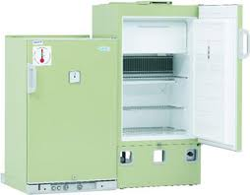
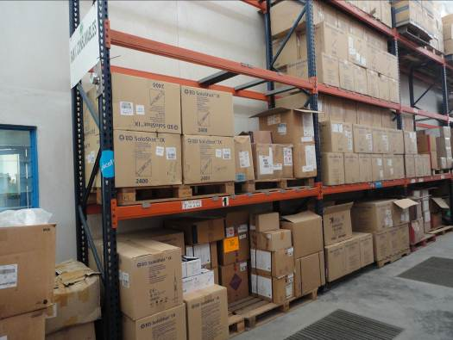
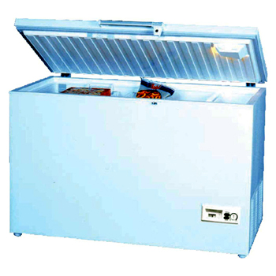
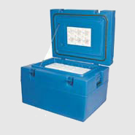


The EVM Assessment: How does it assess?
Example: Criterion E3 (Storage Capacity) is assessed by evaluating 6 critical indicators
Positive Storage [+2 to +8⁰C]
Dry storage
Negative Storage [-15 to -25⁰C]
Passive containers
(cold boxes and vaccine carriers)
Ice-pack freezing
Transport
Notes:
15
example

Slide 16
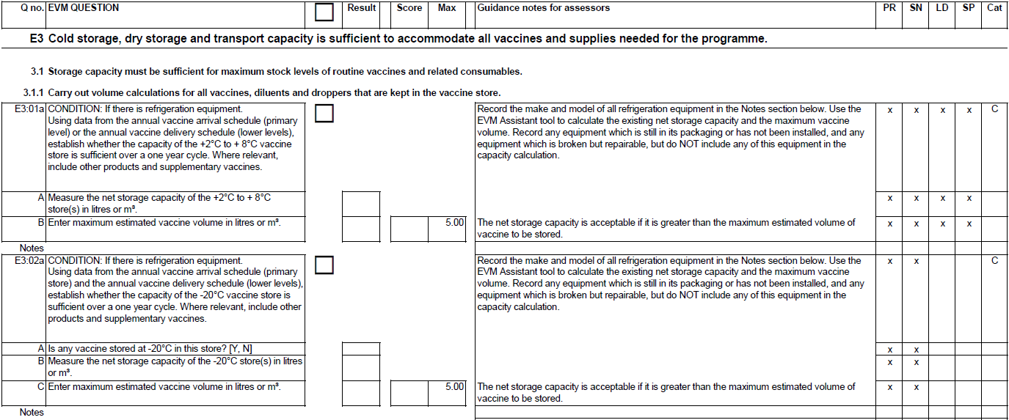
The EVM questionnaire - Indicators
Criterion
Requirement
Indicator
Question no.
Guidance
notes
Result
Score
Comments

Slide 17
EVM Results
Notes:
Yes

Slide 18
EVM Results: Assessment Results
9 global criteria with requirement and set of indicators
Identify strength and areas for improvement
Guide development and implementation of improvement plan
7 general categories for action improvement
Identify strength and areas for improvement
Direct actions for improvement

Slide 19
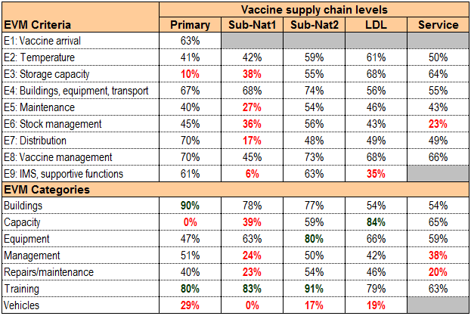
EVM scores – guidance for improvement
Criteria & categories
Supply chain levels
80% target is set globally as satisfactory level
Depending the magnitude of gap, countries may set mile stones towards the target
Identify for each criteria indicators with poor score for action
Priority to critical indicators, i.e. with high weighted scores. Those will have maxi impact on overall score

Slide 20
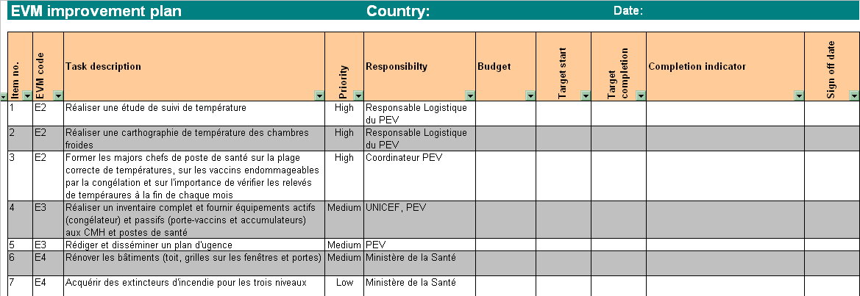
EVM scores – guidance for improvement
EVM improvement plan:
Set priorities from criteria
Define activities from categories
Develop budget & implementation schedule
(current) EVM scores present the situation in the past!
Improvement plan provides ways towards satisfactory performance
Implementation of the improvement plan will realize a better future

Slide 21
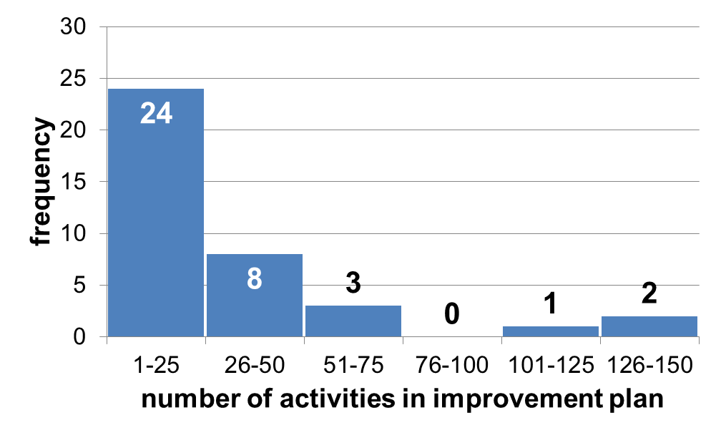
EVM Results: Improvement Plans
Improvement Plan Content
Improvement plans vary in the number and nature of improvement activities.
Some improvement plans contain a long list of very specific improvement activities, others contain a shorter list of more generic activities.
Some improvement plans contain only programmatic improvement activities, others contain both programmatic and strategic activities.

Slide 22
EVM Results: Improvement Plans
Improvement Plan implementation*
In April 2013 (red line), GAVI required 75 countries to report on the implementation status of their improvement plans.
Approximately 26 countries did not report on their status.
Assuming a three year implementation window, about 18 of the 49 countries that did report their status reported being on or ahead of schedule.

Slide 23
Thank you
Notes:
Yes

